Slide 1

Townhall: Environmental Impacts of AI
Critical AI Literacies Collective (CALC)

Slide 2
WELCOME!
Please introduce yourself to your neighbors!
Name
Pronouns, if you want
What you do at WWU
How you heard about this event
Why you are here

Slide 3

Critical A.I. Literacies Collective
Who we are:
The Critical A.I. Literacies Collective (CALC) is a faculty and staff group working to learn and teach about the wide-ranging global impacts of corporate A.I. products from critical, interdisciplinary perspectives.
We approach this topic from a shared commitment to building life-affirming futures for all of us together on this planet. We are thinking beyond the unit of the individual to envision systemic impacts and possibilities.
Steering Committee:
Aspen Clark (ITS), Robyn Dahl (Geology & SMATE), Jenny Forsythe (English), Claudia Johnson (Fairhaven College), Amites Sarkar (Mathematics), Emily Spracklin (Western Libraries), and Xi Wang (Energy Studies & Environmental Studies)
Scan to read CALC’s full position statement

Slide 4
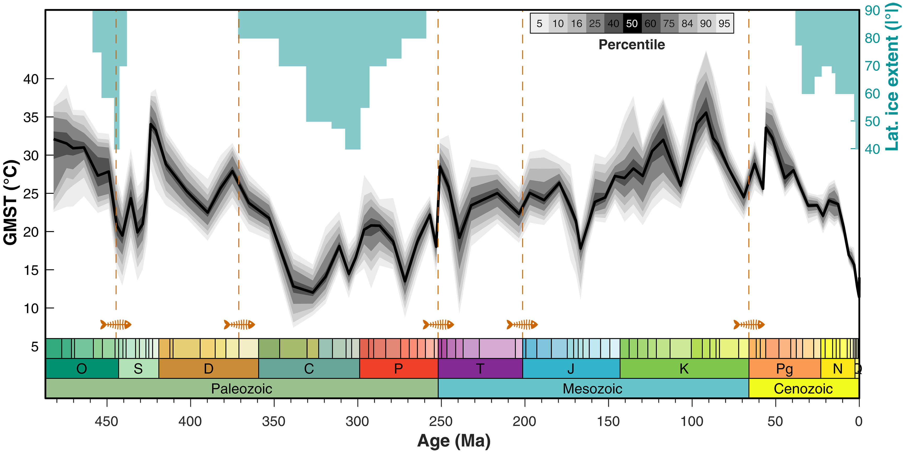
Global Climate & Life on Earth: A Deep Time Perspective
The “Big 5” Mass Extinctions
End-Ordovician
Late Devonian
Permo-Triassic
Late Triassic
End-Cretaceous
Bonus!
Today’s “Sixth Extinction”
(Judd et al. 2024)

Slide 5
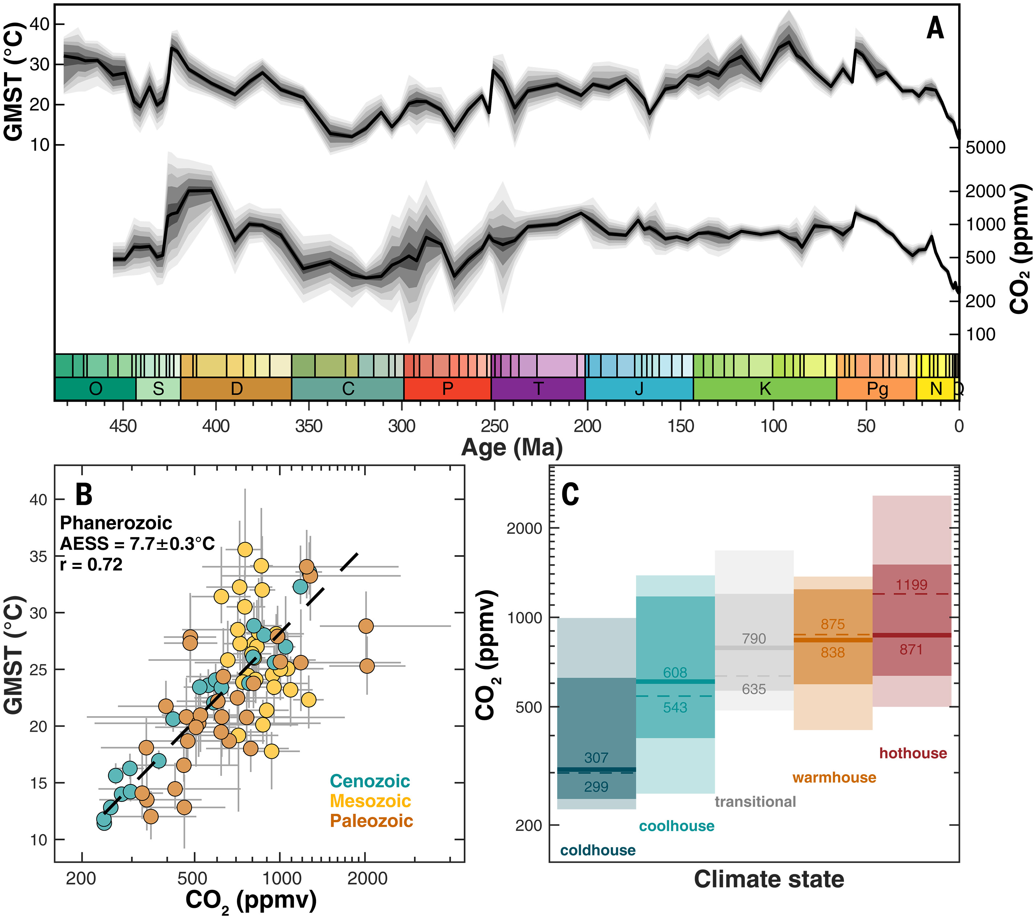
Global Climate & Life on Earth: A deep time perspective
We know that global temperature and greenhouse gas (GHG) concentrations are directly related
Today, GHG are rising because of human activity; in the past GHG and global temperature shifted because of geological processes
(Judd et al. 2024)

Slide 6
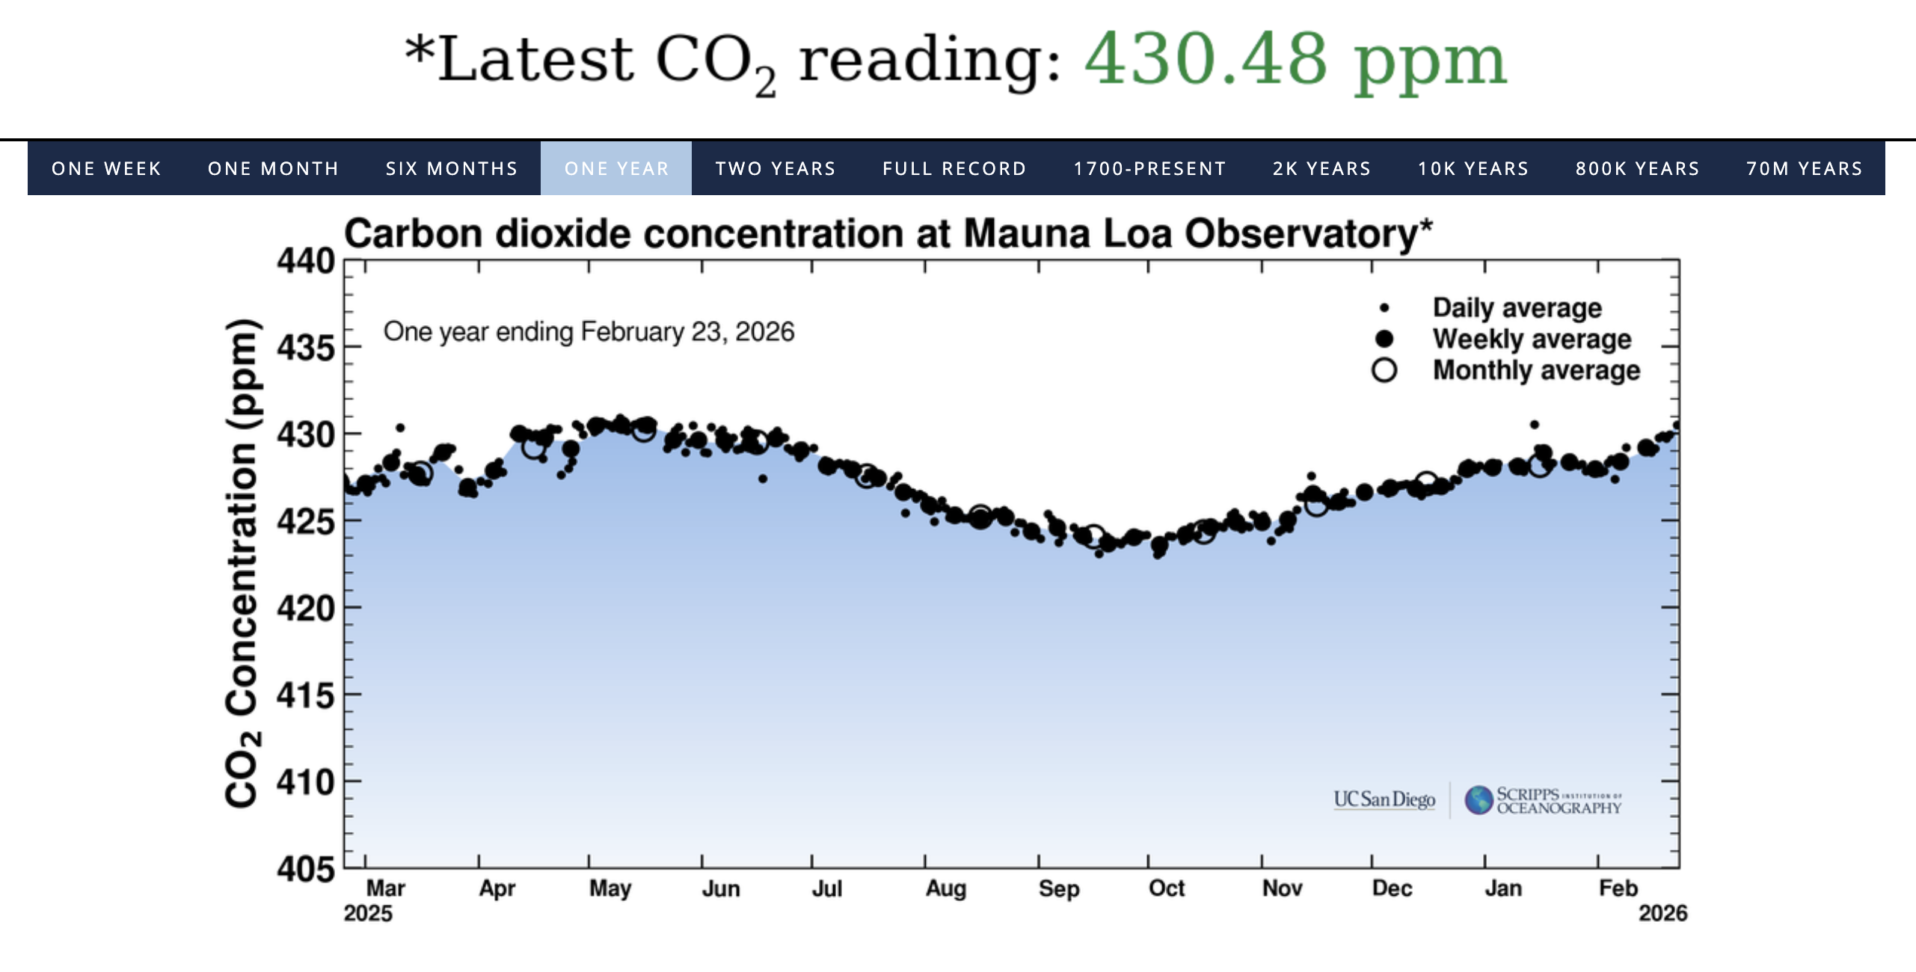
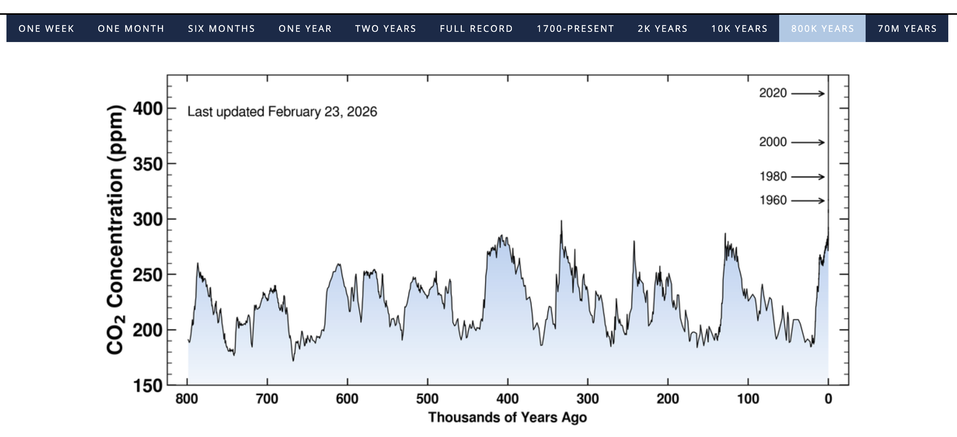
(Keeling Curve, SIO)

Slide 7
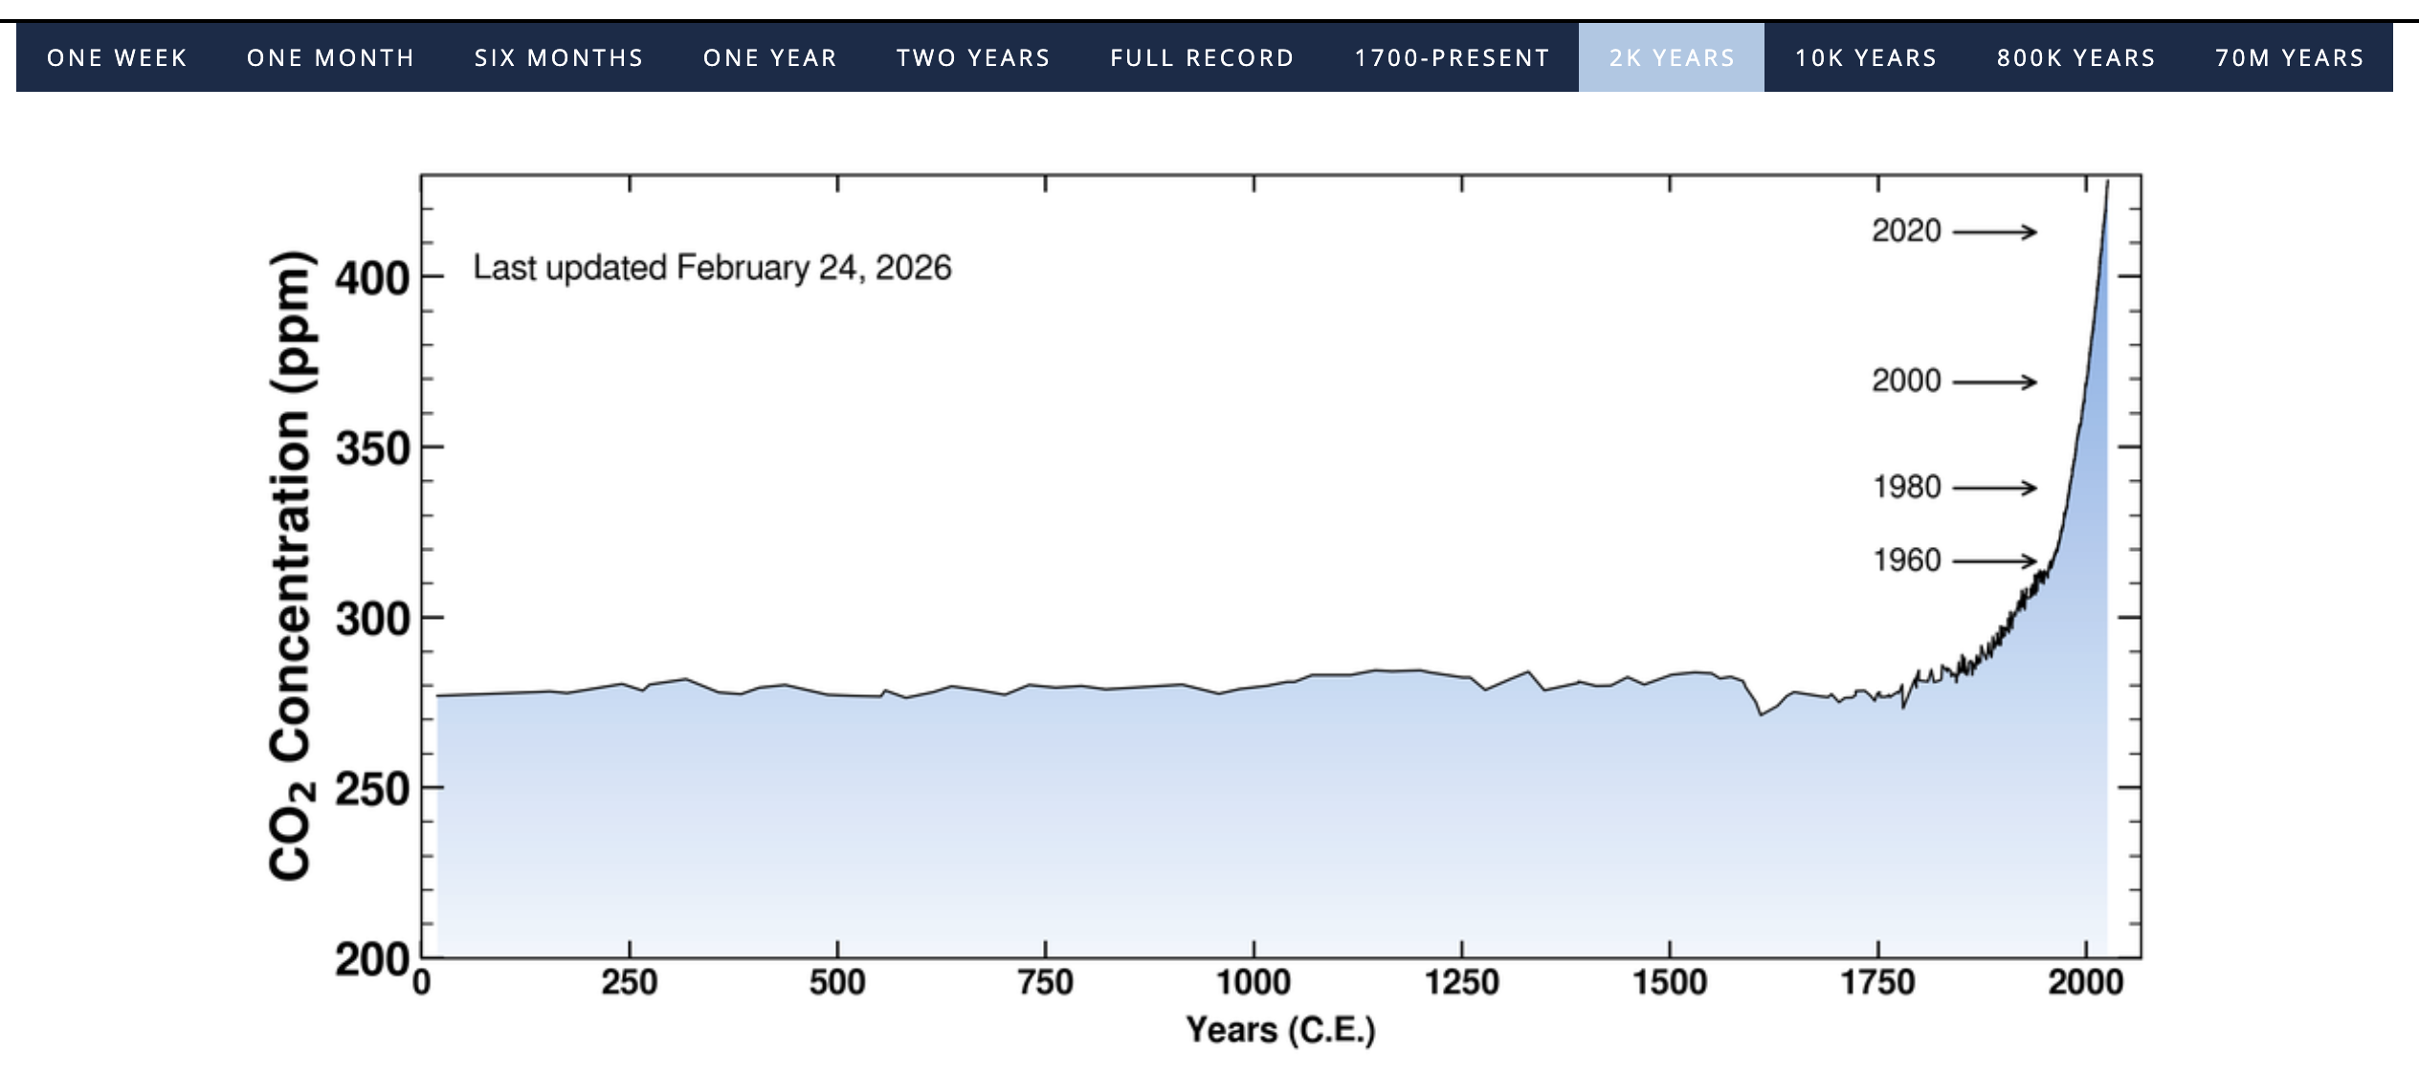

Slide 8
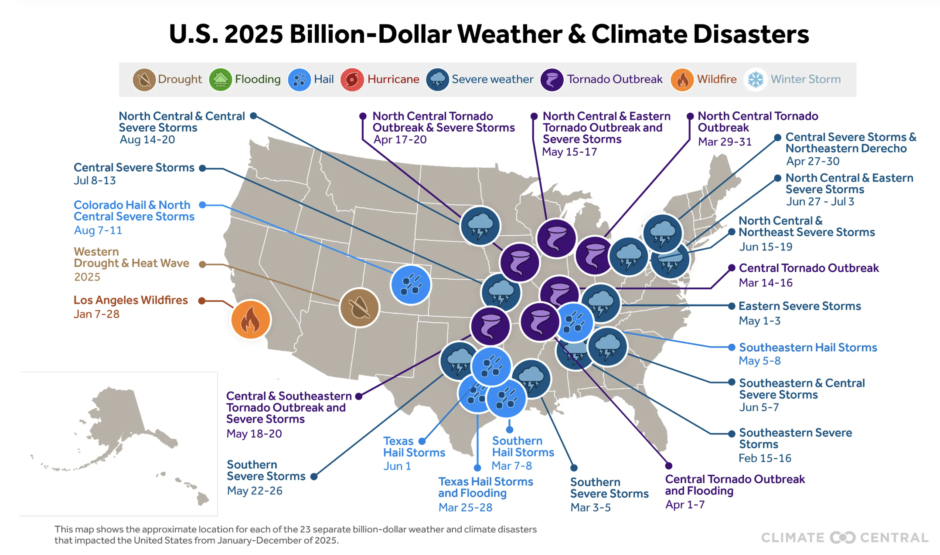

Slide 9
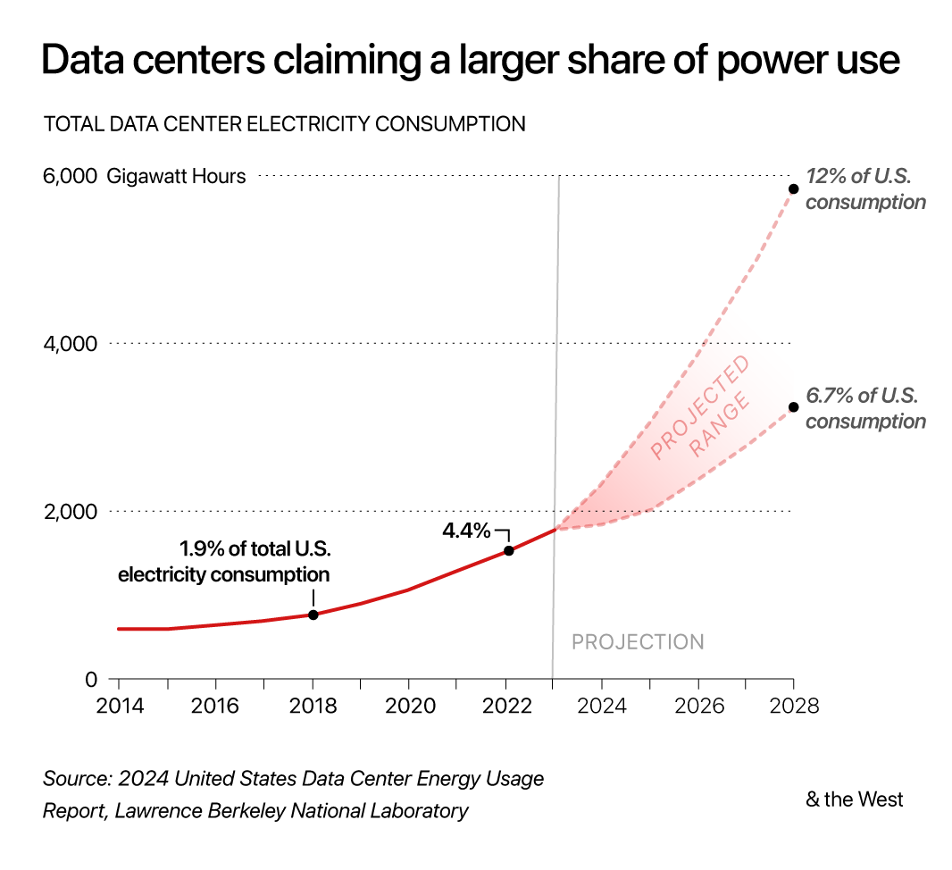
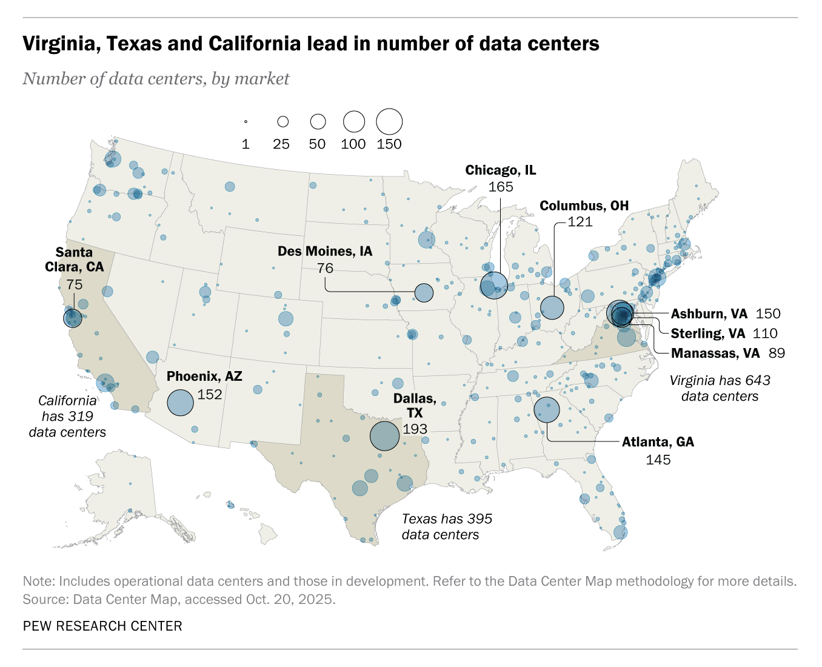
U.S. data centers consumed 183 TWh of electricity in 2024 (4% of the country’s total energy consumption); expected to grow to 426 TWh (+133%) by 2030 (Pew Research)

Slide 10
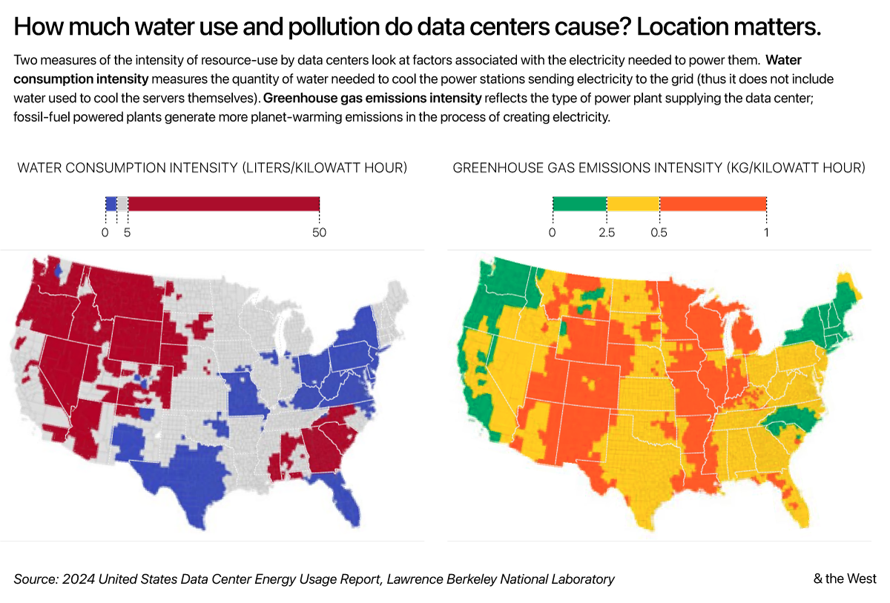

Slide 11
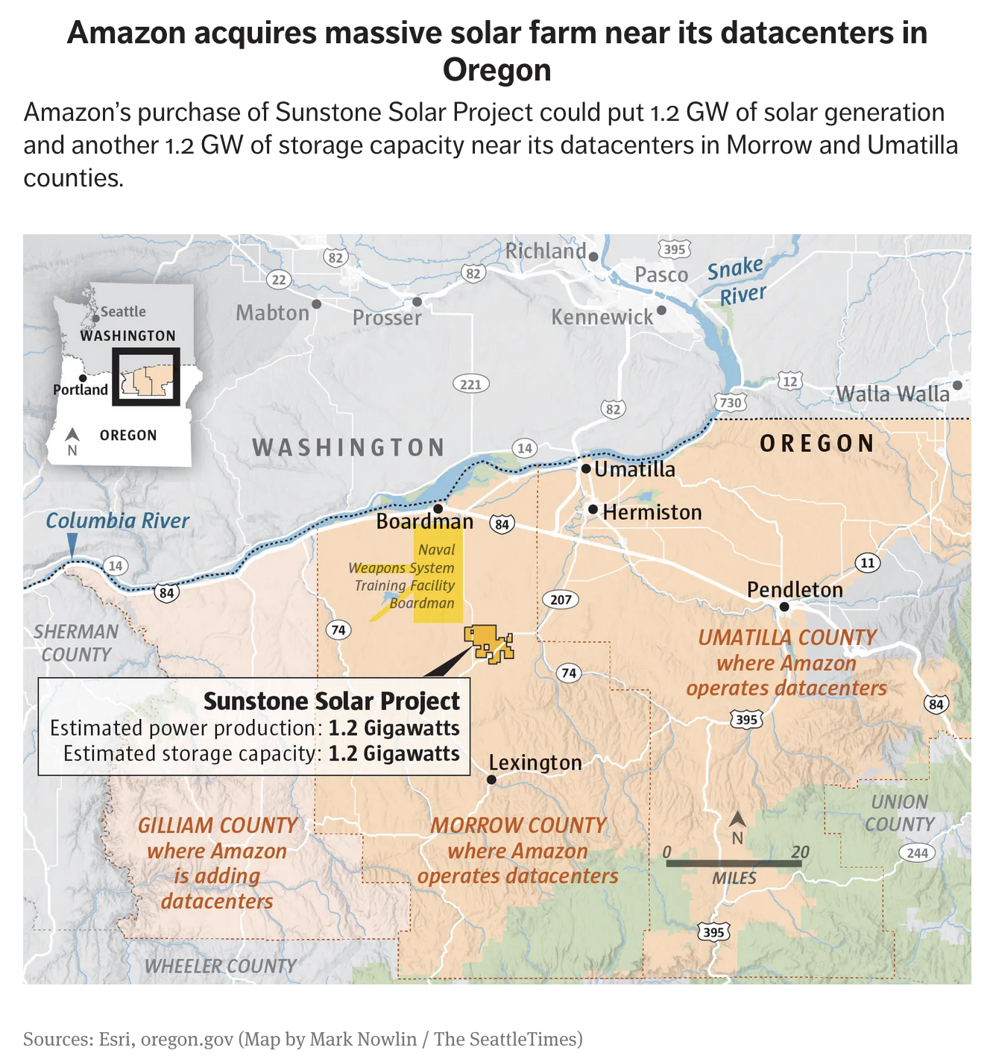
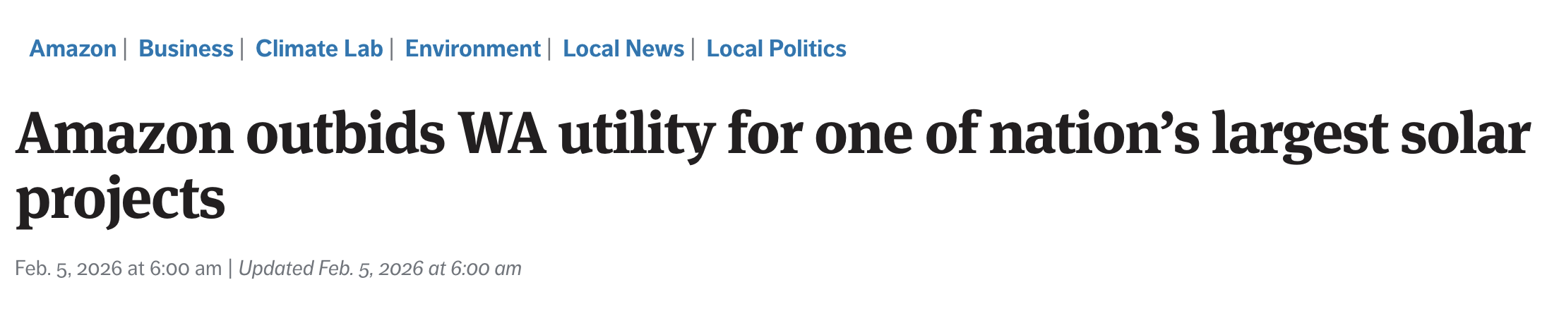
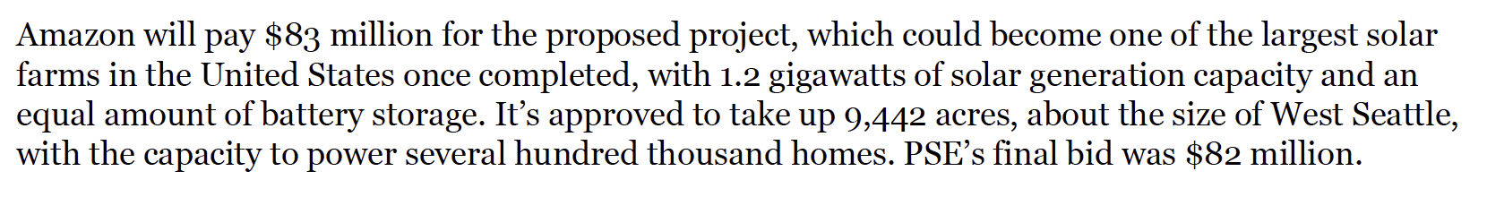
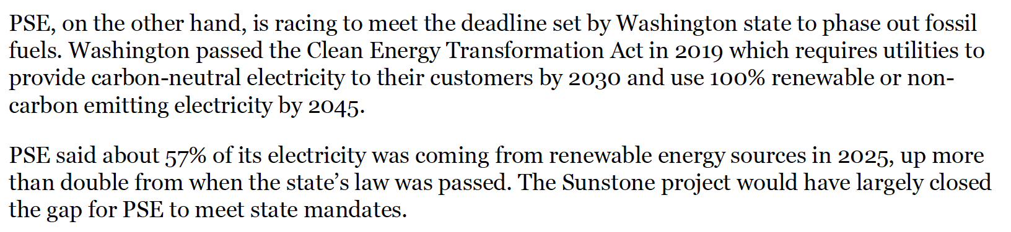
Data center energy consumption has direct impacts on WA residents

Slide 12
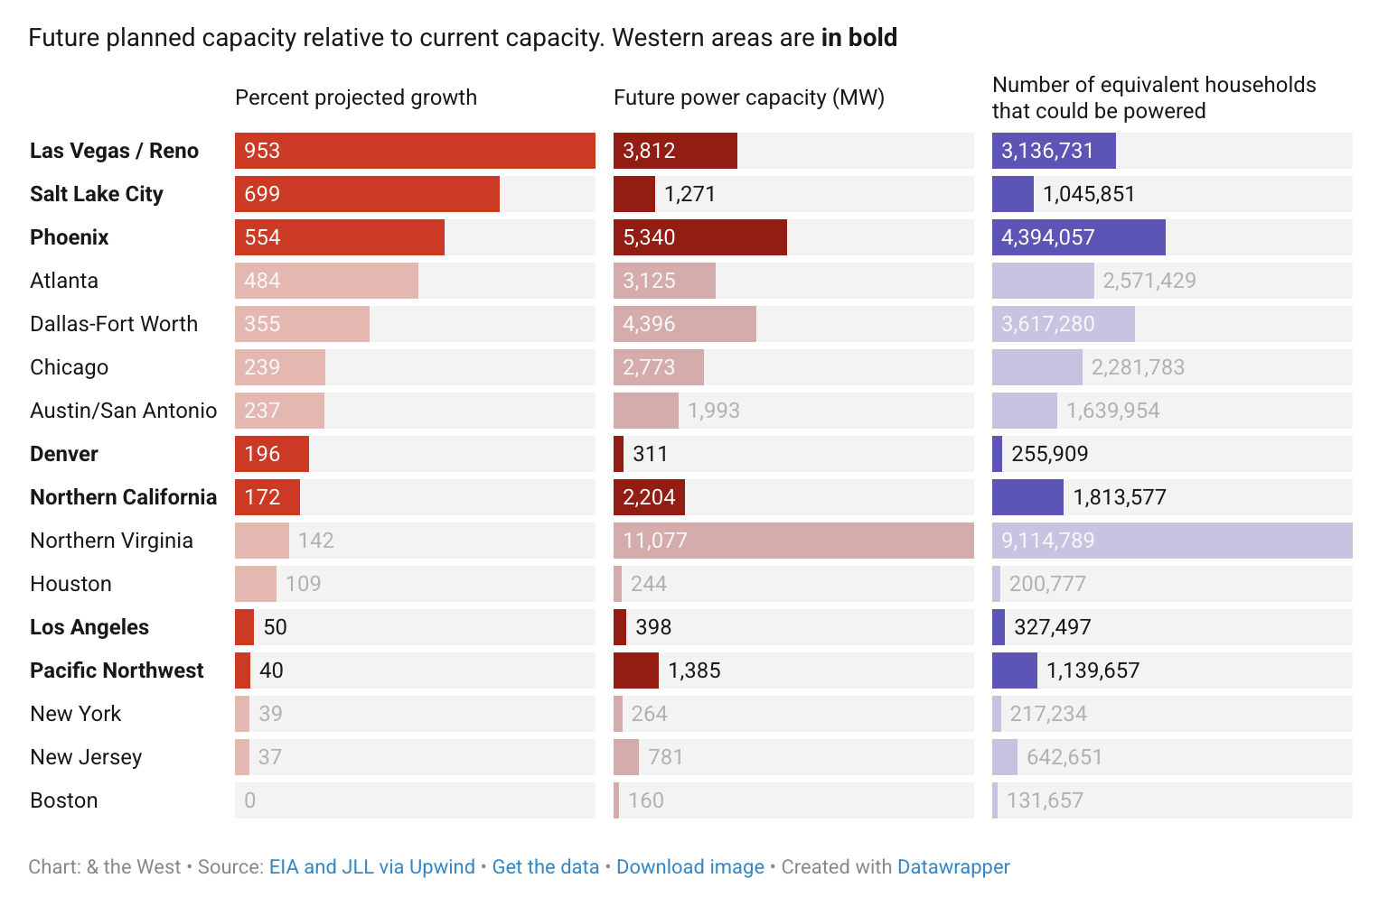

Slide 13
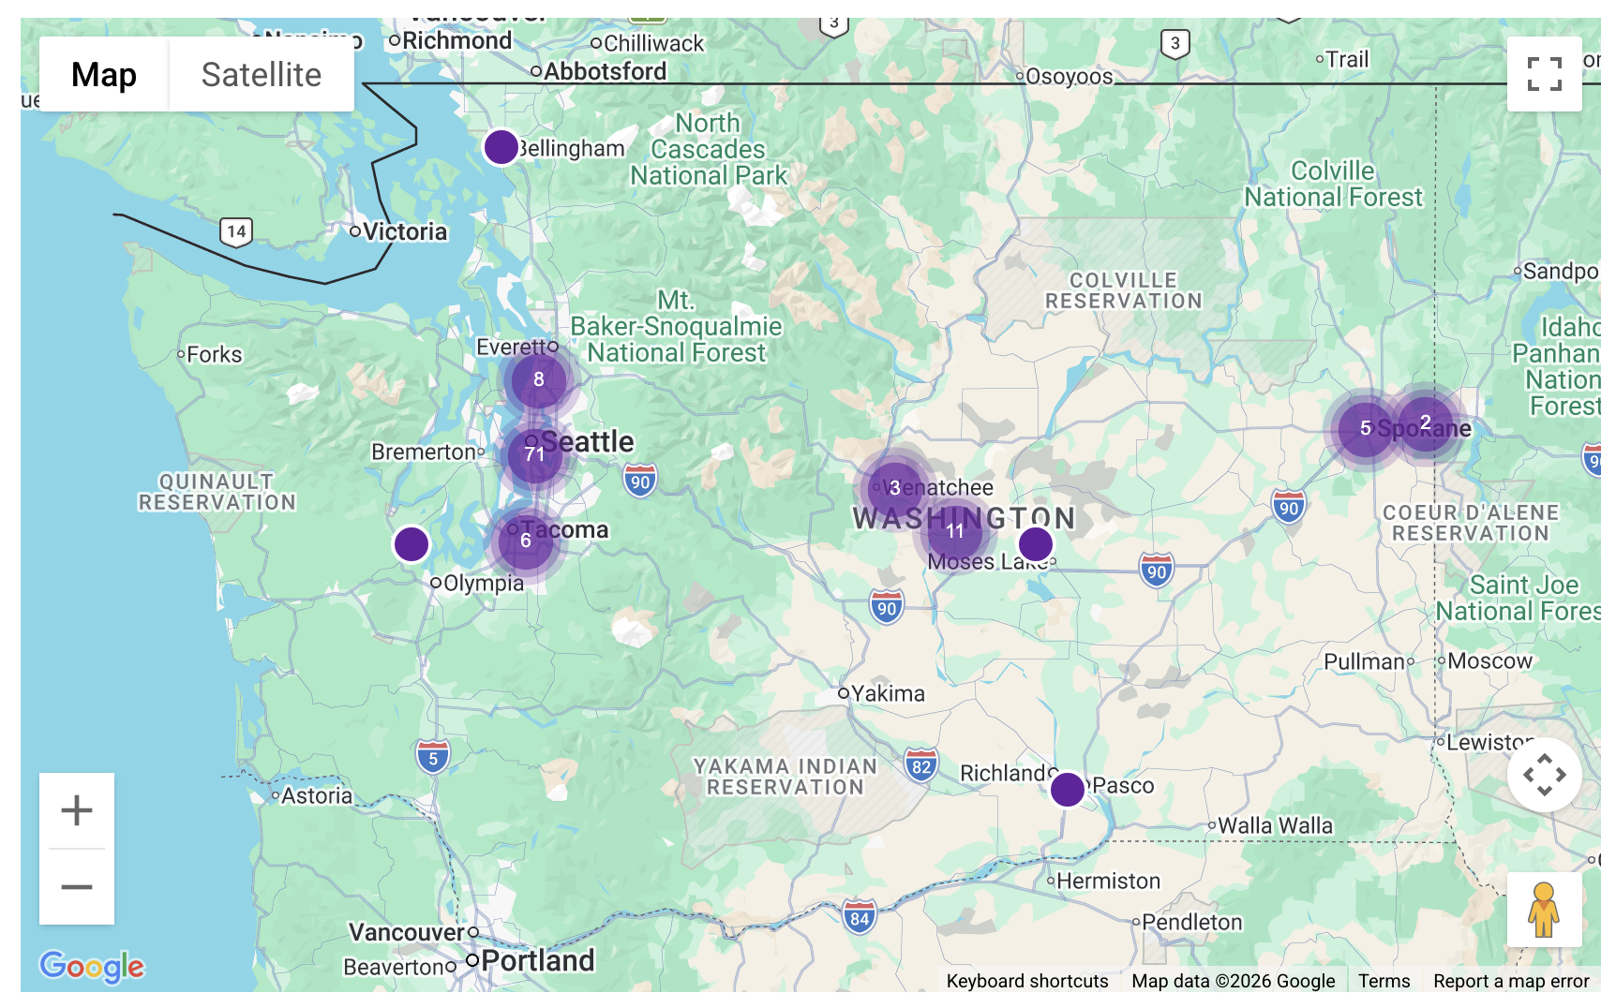
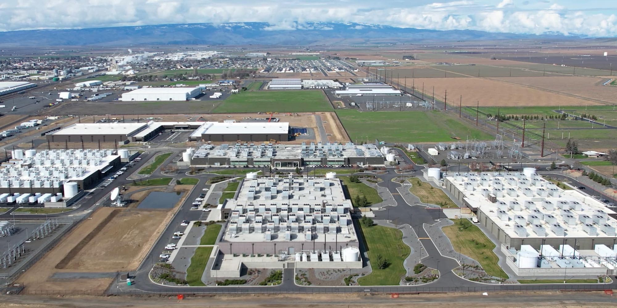
Data Centers in WA State
WA is home to ~125 data centers and related facilities
Microsoft is the biggest data center owner in WA (30 sites)
If these facilities were to run at capacity for a year, they would consume the slightly more power than all the utility customers of Seattle City Light
Data centers in WA State (datacenters.com)

Slide 14


How does this connect to the WWU Community?
Carbon neutrality by 2035
“Positioning Western as a bold leader in climate action and sustainability”
Four Pillars of Sustainability: environment, economy, social justice, health & well-being
Read the Sustainability Action Plan

Slide 15






How does this connect to the WWU Community?
Existing contracts with corporate AI products, such as pro licenses for Microsoft Copilot
Potential future contracts – who decides?
Use of corporate AI products by faculty, staff, students on campus
Upcoming survey to evaluate use and attitudes on campus!

Slide 16
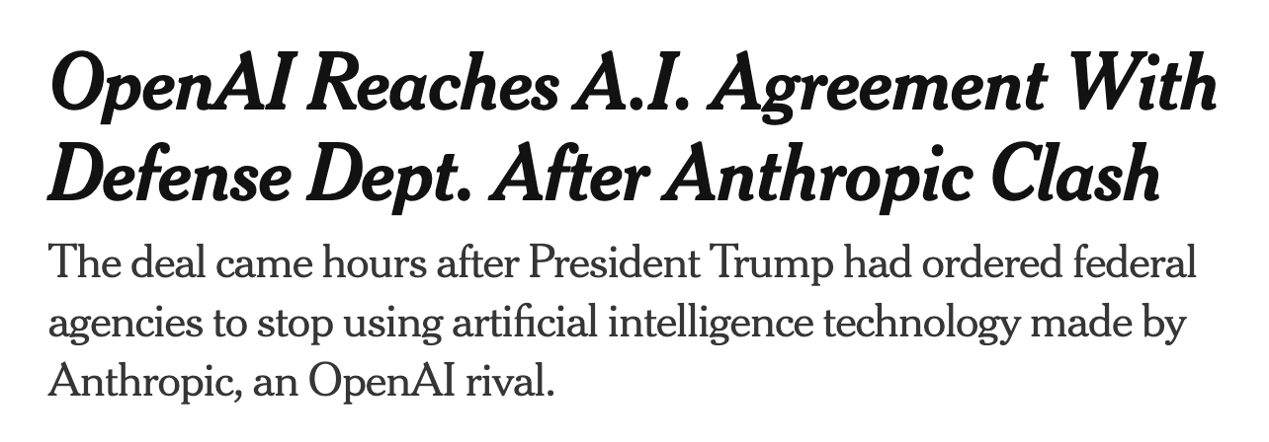
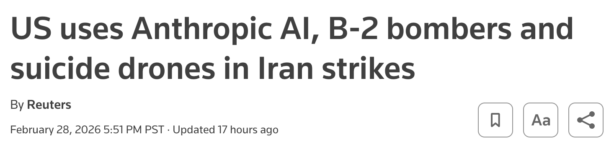
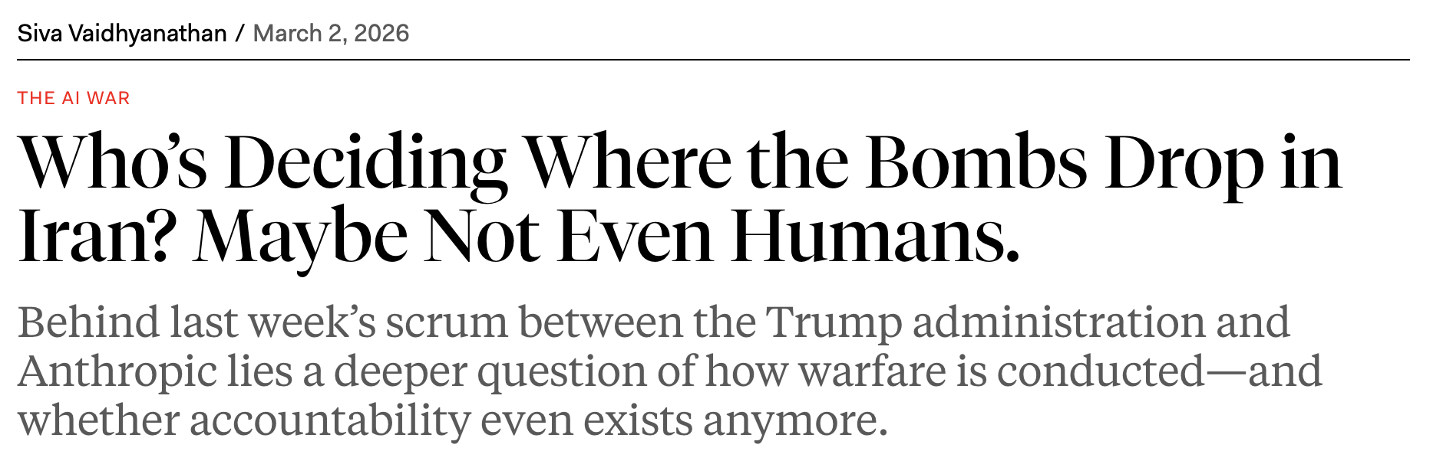
How does this connect to the WWU Community?
(NYTimes)
(The New Republic)

Slide 17
Discussion Questions
How should WWU take responsibility for the local and global impacts of the use of corporate AI products on WWU servers?
What kind of education should WWU provide around the impacts of corporate AI products?
What stories of hope and resistance have you heard about regular people confronting the tech industry?
What questions do you have?

Slide 18



Please stay for more conversation and snacks!
Upcoming Events and Other Information:
 | Today, 5:30-6:30pm in Bond Hall 225 Generative AI and Its Ties to Capitalism and Education Sponsored by YDSA
 | May 1-3, 2026 WWU Social Justice Hackathon
 | Submit public comments on HB2515 “Addressing emerging large energy use facilities”
 | March 9, 5:00-6:30pm, WWU Poulsbo Campus Environmental Impact of Large Data Centers

